Slide 1
4.1.3. A,b,c,d – Protein synthesis
TEXT –
9.1 PROTEIN SYNTHESIS

Slide 2
Content of powerpoint: Three topics over two lessons
1. Genes and the Genome
Define the terms genome and gene
Understand that genes include ‘coding’ (exons) and ‘noncoding’ DNA (which includes a variety of transcribed proteins: functional RNA (i.e. tRNA), centromeres, telomeres and introns. Recognise that many functions of ‘noncoding’ DNA are yet to be determined)
2. Protein Synthesis: Transcription
Explain the process of protein synthesis in terms of
transcription of a gene into messenger RNA in the nucleus
Recognise that the purpose of gene expression is to synthesise a functional gene product (protein or functional RNA); that the process can be regulated and is used by all known life
3. Protein Synthesis: Translation
Explain the process of protein synthesis in terms of
translation of mRNA into an amino acid sequence at the ribosome (refer to transfer RNA, codons and anticodons)

Slide 3
Genes and the genome

Slide 4
Learning intention Success criteria
define the terms genome and gene
understand that genes include ‘coding’ (exons) and ‘noncoding’ DNA (which includes a variety of transcribed proteins: functional RNA (i.e. tRNA), centromeres, telomeres and introns. Recognise that many functions of ‘noncoding’ DNA are yet to be determined)
state the meaning of the terms genome and gene
perceive that genes include ‘coding’ (exons) and ‘noncoding’ DNA (which includes a variety of transcribed proteins: functional RNA (i.e. tRNA), centromeres, telomeres and introns. Recall that many functions of ‘noncoding’ DNA are yet to be determined).

Slide 5
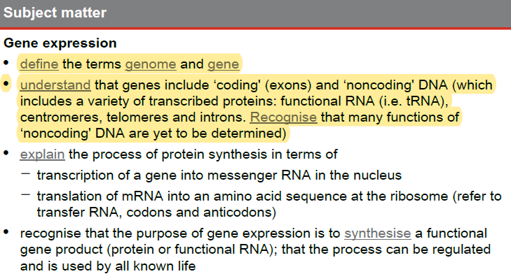
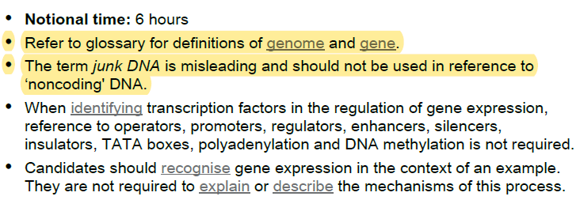
Syllabus check:
By the end of the lesson you should be able to…
NOTE SPECIFICALLY….

Slide 6
Review of gene and genome
Before we can start learning about protein synthesis we need to start by reviewing two other terms, that of the gene and the genome.

Slide 7
Defining the Gene:
A gene is defined by the QCAA as ‘region/s of DNA that are made up of nucleotides; the molecular unit of heredity’.
It could also be described as a ‘specific segment of DNA/chromosomes that code for a specific protein or RNA’.
A single molecule of DNA/chromosome has hundreds to thousands of genes on the molecule.
The instructions in genes allow them to make proteins – which are the building bocks of life.
They make up the structural parts of the organism and may make other sorts of molecules like enzymes, oil, fibre, or fat, which are used within the organism.

Slide 8

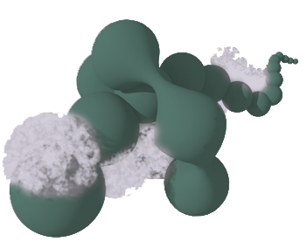



Chromosomes, Genes and Inheritance
Genes contain the information for the production of proteins and functional RNA molecules.
Proteins are responsible for the physical expression of genes as phenotypic characteristics or traits, such as eye color.
Since genes are inherited, traits are also inherited.
Chromosome
Gene
Protein
Trait

Slide 9






Chromosomes Contain Genes
A single chromosome may contain hundreds of genes.
Below are the locations of some known genes on human chromosomes:
El
Rh
AMY
Fy
RB
MN
TYS
CBD
ABO
HEMA
NP
Chromosome:
No. of genes:
1
4
9
13
X
1270
465
499
195
773

Slide 10
Defining the Genome:
A genome is defined by the QCAA as ‘all the genetic material in the chromosomes of an organism, including its genes and DNA sequences’.
The genome for plants and animals is estimated to contain 25 000 to 50 000 genes.

Slide 11
Non-coding DNA
Not all sections of DNA are responsible for producing protein. Genes also include sections of DNA that do not encode for protein sequences referred to as non-coding DNA. Recent studies have shown that vast quantities of non-coding DNA have a variety of biochemical and structural functions, which include:
• transcription of non-coding or functional RNA (such as; rRNA [ribosomal RNA], tRNA [transfer RNA] and non-coding RNAs that influence gene expression)
• regulating gene expression. If the segments of non-coding DNA are responsible for controlling structural genes, they are termed regulatory genes.
• adding the end caps, called telomeres, to each chromosome (these provide protection to DNA during replication)
• forming the centromere (points of attachment of chromatids during replication)
• introns. These are non-coding sections of RNA or DNA that interrupts a gene-coding sequence or are spliced out before the RNA molecule is translated into a protein. Such as the origin and terminus sequences involved in chromosome replication.
• many of the functions of ‘noncoding’ DNA are yet to be determined.

Slide 12
Exit ticket: A. Define the terms genome and gene PA MOCKEXAM 2020 SA 2
QUESTION 1 (1 mark)
Define the term gene.

Slide 13
Exit ticket: b. understand that genes include ‘coding’ (exons) and ‘noncoding’ DNA (which includes a variety of transcribed proteins: functional RNA (i.e. tRNA), centromeres, telomeres and introns. Recognise that many functions of ‘noncoding’ DNA are yet to be determined) PA MOCKEXAM 2020 MC
QUESTION 23
Transfer RNA (tRNA) is a type of molecule that helps decode a messenger RNA sequence into a protein. From this information, identify which group tRNA belongs to.
exons
introns
noncoding RNA
noncoding DNA

Slide 14
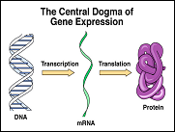
Protein Synthesis: Transcripition

Slide 15
Learning intention Success criteria
explain the process of protein synthesis in terms of
transcription of a gene into messenger RNA in the nucleus
recognise that the purpose of gene expression is to synthesise a functional gene product (protein or functional RNA); that the process can be regulated and is used by all known life
describe in more detail the process of protein synthesis in terms of
transcription of a gene into messenger RNA in the nucleus
recall that the purpose of gene expression is to synthesise a functional gene product (protein or functional RNA); that the process can be regulated and is used by all known life

Slide 16
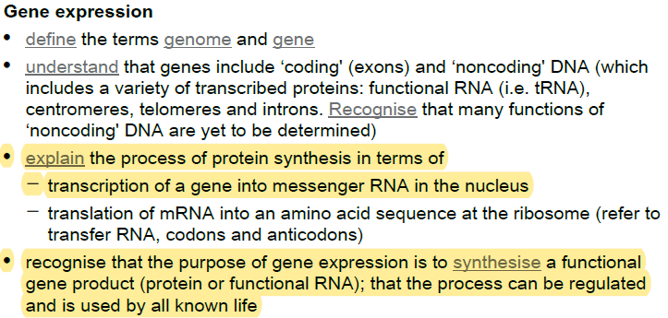
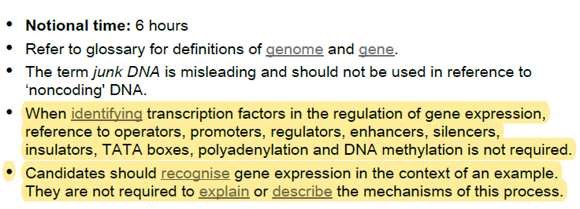
Syllabus check:
By the end of the lesson you should be able to…
NOTE SPECIFICALLY….

Slide 17
Protein:
Proteins are organic compounds made up of chains of amino acids.
There are 20 amino acids commonly used in your body.
Most of your body structure is made of some type of protein.
The rest of your body is made of other materials that are made by proteins (enzymes).

Slide 18
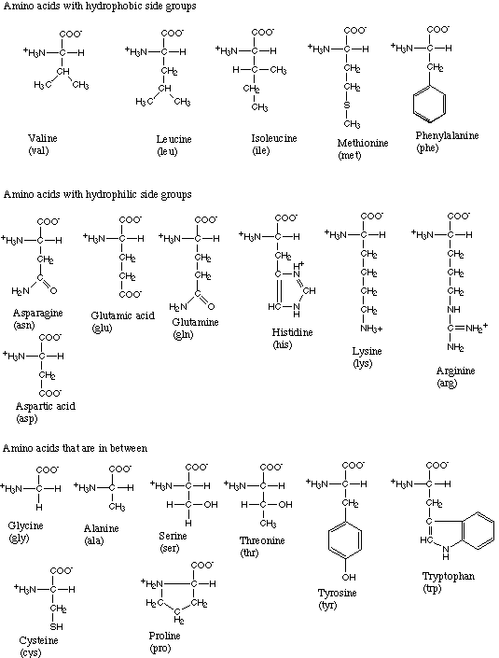
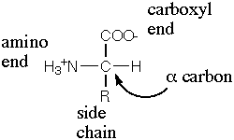
All 20 Amino Acids

Slide 19
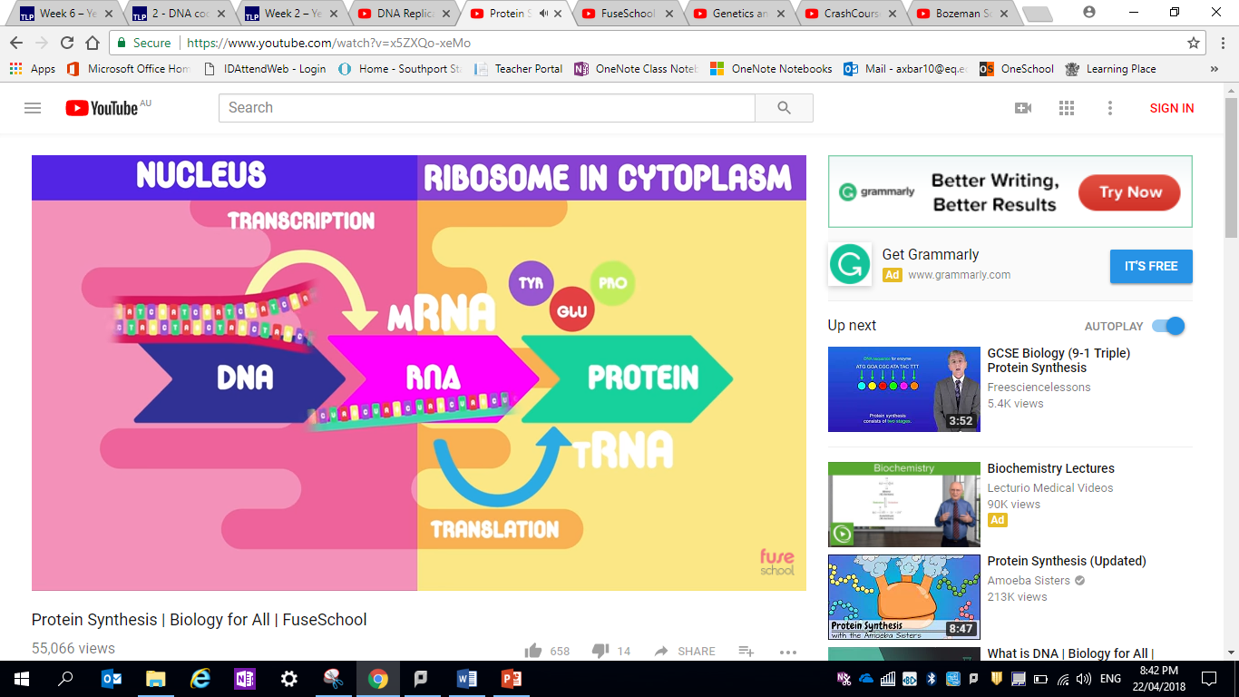
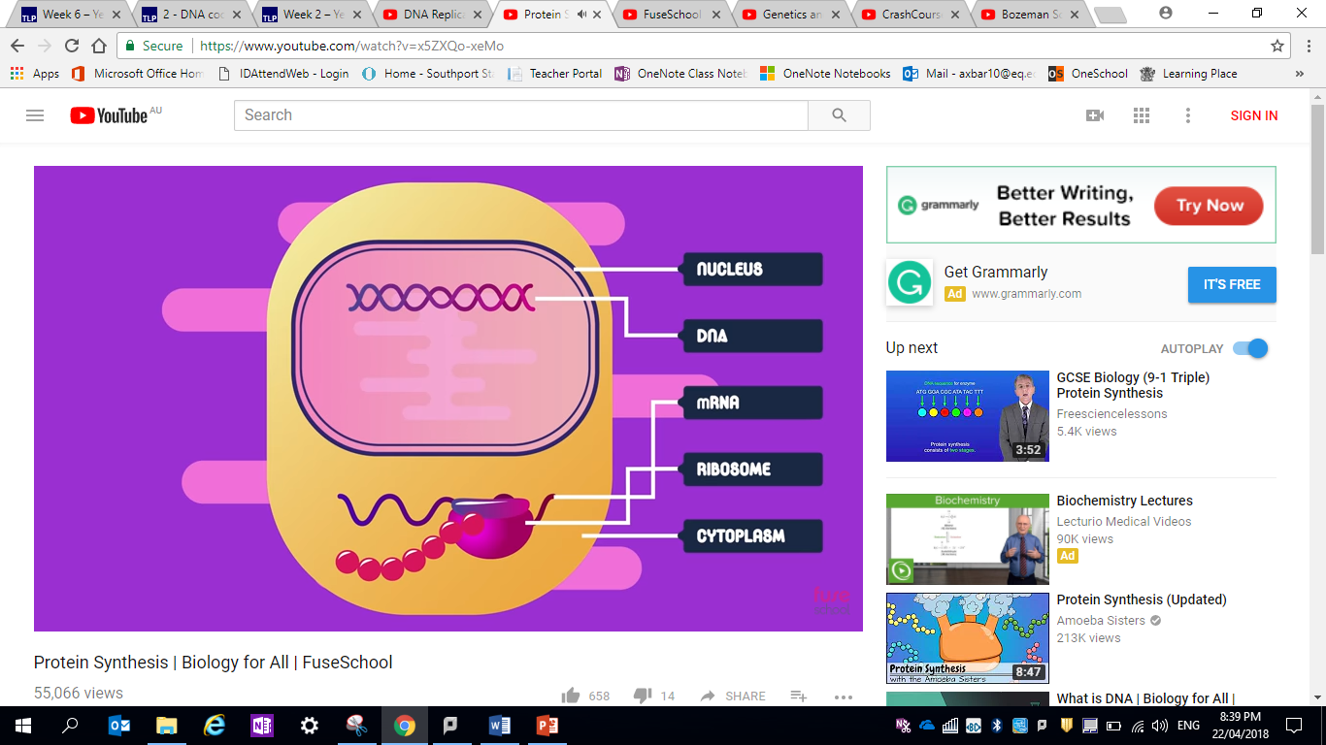
How Proteins are Made
Gene Expression – the two–stage processing of information encoded in DNA to produce proteins.
The purpose of gene expression is to synthesise a functional gene product (protein or functional RNA); that the process can be regulated and is used by all known life

Slide 20
So how do we get from DNA to Protein?
This is the:
Central Dogma of Molecular Biology
DNA RNA Protein
Transcription Translation

Slide 21
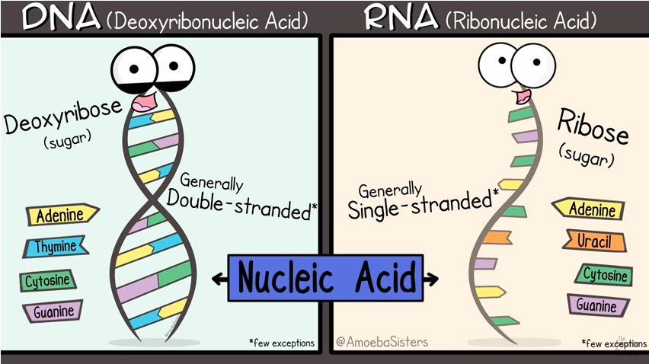
Describing RNA
PROTEINS ARE MADE BY DECODING THE INFORMATION IN DNA FROM DNA TO RNA AND EVENTUALLY TO A CHAIN OF AMINOACIDS
DNA codes for the formation of RNA in the nucleus of the cell.
RNA is short for another kind of nucleic acid called ribonucleic acid. RNA is very similar in structure to DNA except for three small differences. These are; the fact that RNA is a single stranded molecule, and it lacks the base thymine (T) as it is replaced by the base uracil (U), and its five carbon sugar ribose has one more oxygen atom than the sugar deoxyribose in DNA.
Three different types of RNA exist, mRNA or messenger RNA, tRNA or transfer RNA, and rRNA or ribosomal RNA.

Slide 22
Describing Triplets
The genetic code is written in three-nucleotide “words”. Since there are twenty amino acids and only four kinds of bases in DNA, a single base cannot determine which amino acid will be used in a protein sequence. Instead, the nucleotides in DNA are grouped into threes (a triplet). Each triplet contains the code for a single amino acid. This series of nucleotide triplets forms the basis of the genetic code.

Slide 23
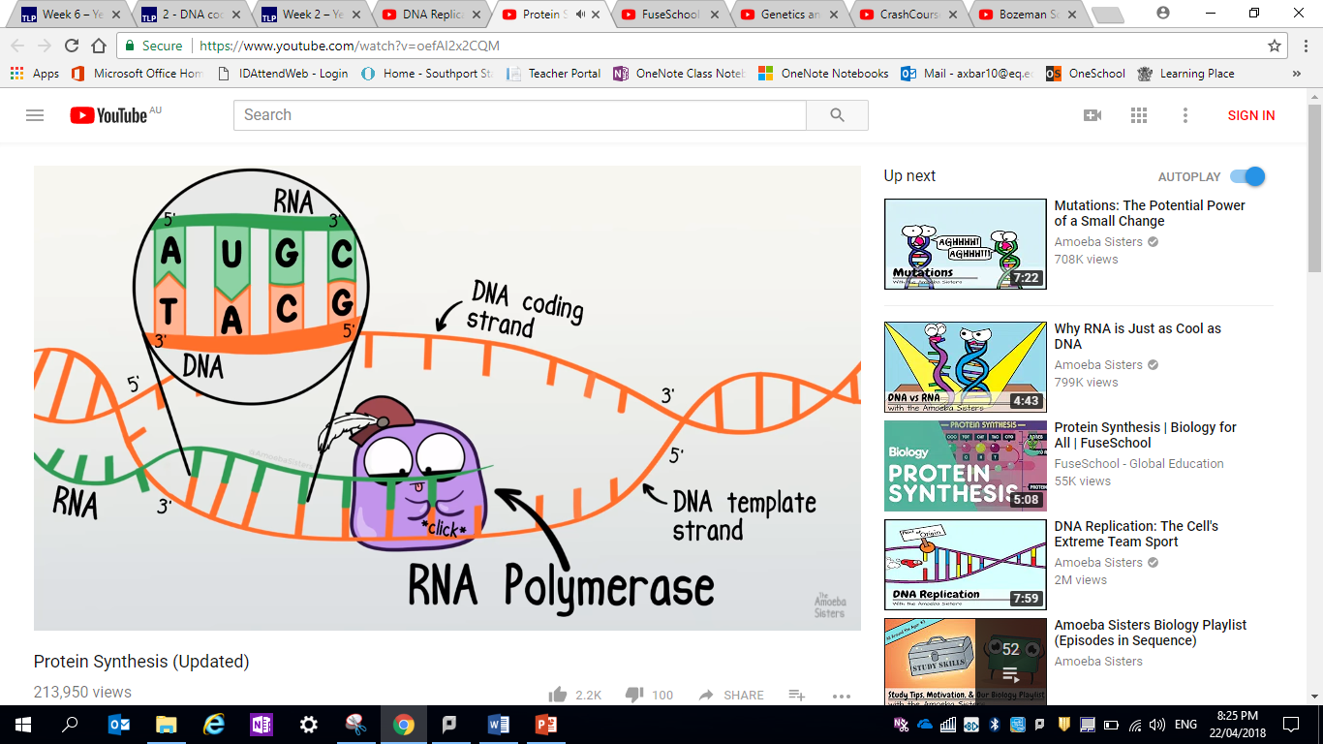
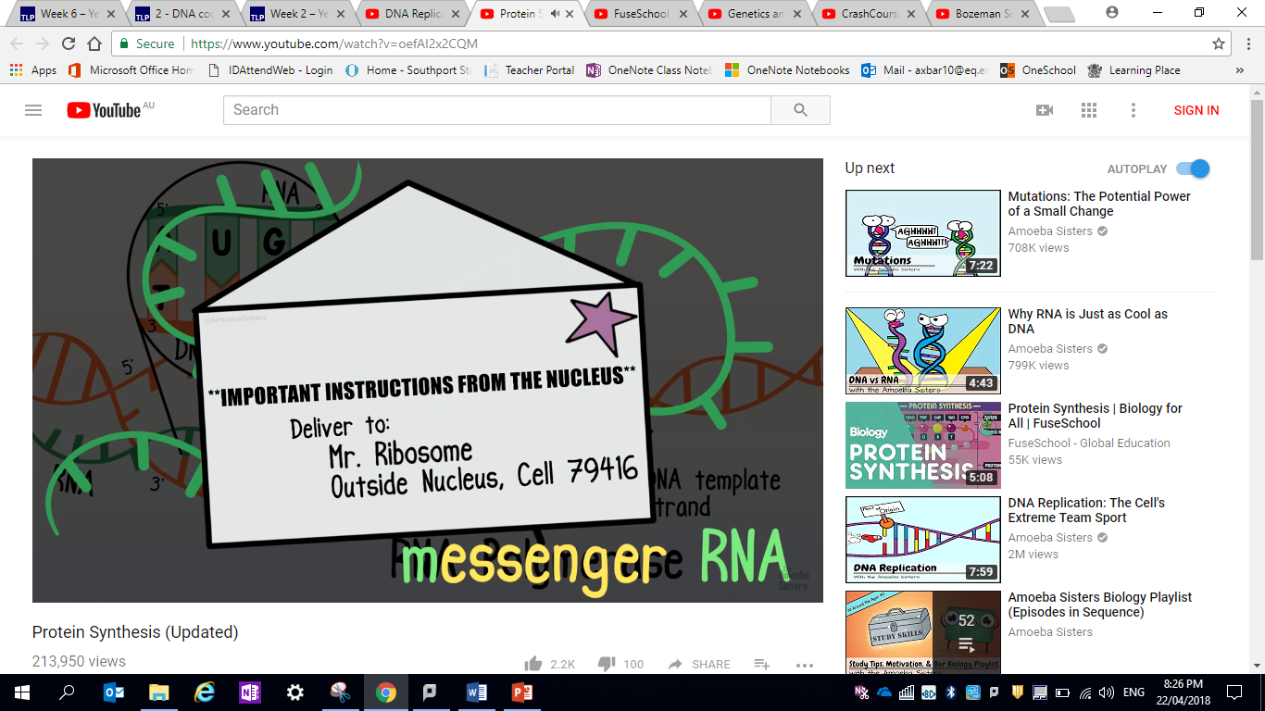
Stages of protein Synthesis: Transcription
The DNA does not leave the cell’s nucleus during protein synthesis. Instead the code must be transcribed (copied) into another nucleic acid, messenger RNA (mRNA). The process of transferring the code from DNA to mRNA is called transcription.
Transcription is the stage of protein synthesis in which the information in DNA (a section referred to as a gene) for making a protein is transferred (transcribed) to an RNA molecule.

Slide 24
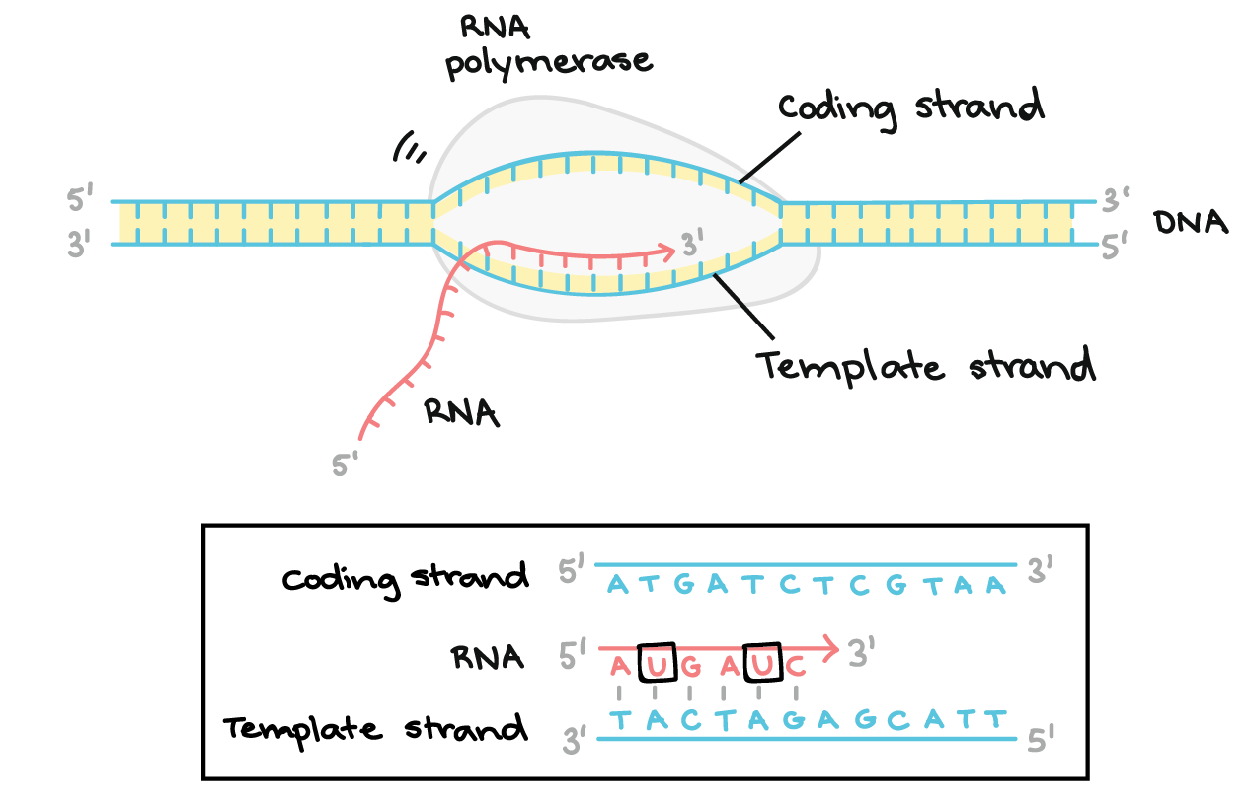
Stages of protein Synthesis: Transcription
To initiate the process of transcription the enzyme helicase unwinds and unzips the double strand to expose the nitrogen bases that will form the template for the mRNA.
RNA polymerase binds to a segment of DNA where a certain gene sequence is located.
As the RNA polymerase moves along the template DNA strand, it adds an RNA nucleotide that is complementary to the DNA.
The mRNA will be used to make a specific protein that was encoded in the DNA.
RNA molecules do not have thymine, instead uracil is used as a complement to adenine.
When the messenger RNA is complete, it is able to detach and the two DNA chains then re-join.
Draw and annotate the diagram

Slide 25
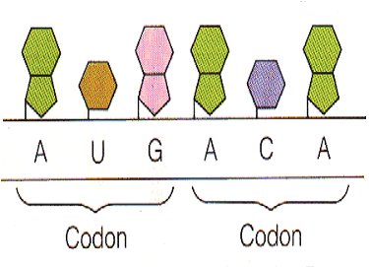
Stages of protein Synthesis: Transcription
The triplets on DNA have now been transcribed into codons on the mRNA.
DNA base sequence (triplet codes):GTG ACC TAT CGA
mRNA base sequence (triplet codons):CAC UGG AUA GCU
Codons – a three-nucleotide sequence in DNA or mRNA that encodes for an amino acid or signifies a stop signal are referred to as a Codon and are transcribed from the triplets .
http://highered.mcgraw-hill.com/sites/0072437316/student_view0/chapter15/animations.html#

Slide 26
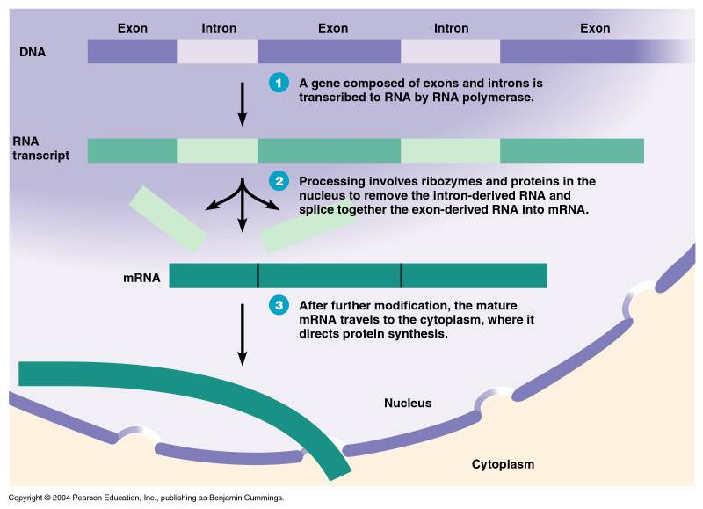
Stages of protein Synthesis: post transcriptional modifications
In eukaryotes the mRNA can contain small non-coding sections that are not needed to produce a functioning protein (split gene). These non-coding introns are removed by enzymes in the nucleus. The remaining coding exons are re-joined to form mature mRNA.
Before the mature mRNA can leave the nucleus after transcription there are extra nucleotides at the beginning and end that need to be removed (trimming). The start of the mRNA is then capped with methyl-guanine and a long ‘tail’ of adenines is added to the other end (tailing). These caps and tails are thought to aid the binding of the mRNA to the ribosomes and make it more stable.
Intron
a non-coding section of DNA within a split gene. transcribed from eukaryotic DNA but are removed before translation of mRNA into a protein occurs.
Exon
a coding section of DNA within a split gene that gets transcribed and translated.
http://gslc.genetics.utah.edu/units/basics/transcribe/

Slide 27
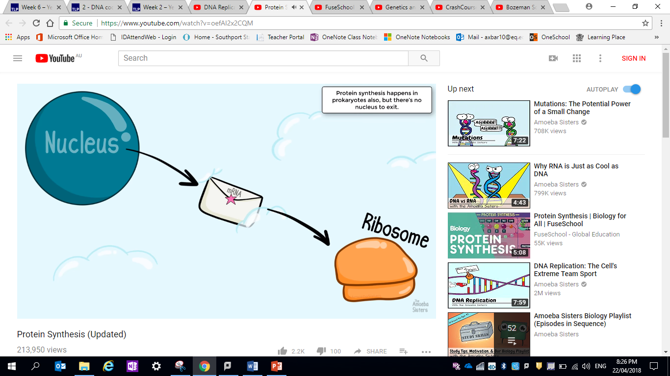
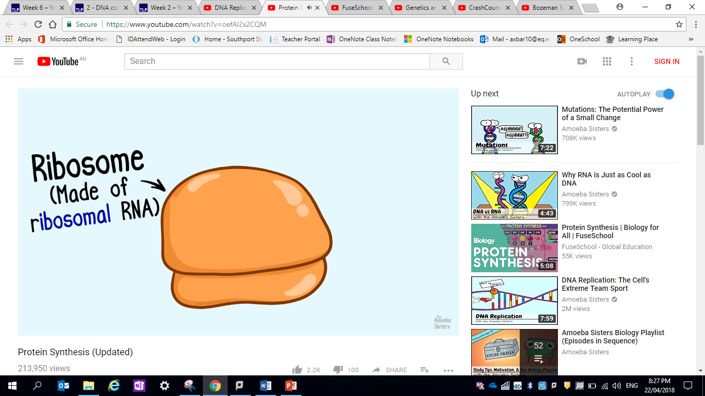
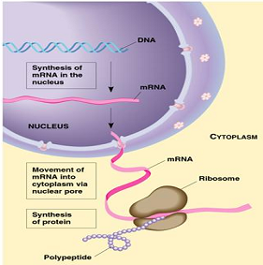
Ribosomal RNA – a type of RNA molecule that plays a structural role in ribosomes.
The mRNA that was transcribed in the nucleus will be transported out of the cell nucleus into the cytoplasm where it most likely will rendezvous with a ribosome attached to the endoplasmic reticulum. Translation of the mRNA molecule will occur there.

Slide 28
Exit ticket: d. recognise that the purpose of gene expression is to synthesise a functional gene product (protein or functional RNA); that the process can be regulated and is used by all known life PA MOCKEXAM 2020 mc
QUESTION 7
The main purpose of gene expression is to
transcribe a gene.
produce hormones.
maintain homeostasis.
synthesise a functional gene product.

Slide 29
Exit ticket: c. explain the process of protein synthesis in terms of - transcription of a gene into messenger RNA in the nucleus
Explain the process of protein synthesis in terms of transcription of a gene into messenger RNA in the nucleus. (3 marks)

Slide 30
Protein Synthesis: Transcripition

Slide 31
Learning intention Success criteria
explain the process of protein synthesis in terms of
translation of mRNA into an amino acid sequence at the ribosome (refer to transfer RNA, codons and anticodons)
c. describe in more detail the process of protein synthesis in terms of
translation of mRNA into an amino acid sequence at the ribosome (refer to transfer RNA, codons and anticodons)

Slide 32
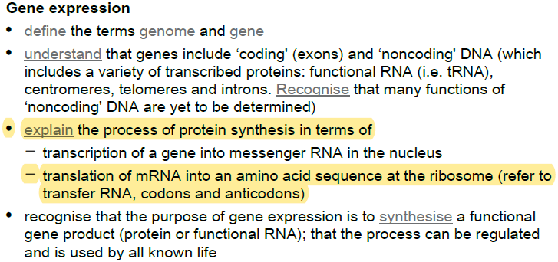
Syllabus check:
By the end of the lesson you should be able to…
NOTE SPECIFICALLY….

Slide 33
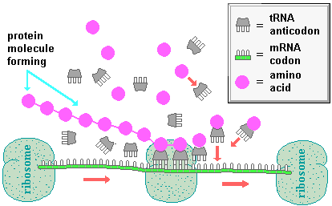
Stages of protein Synthesis: translation
The mRNA is carried from the nucleus out to the ribosomes on the RER (rough endoplasmic reticulum). The ribosome moves along the mRNA strand, one codon at a time. It acts as a pointer to the appropriate tRNA. As the ribosome moves to each new codon position, a tRNA carrying its specific amino acid approaches. Each tRNA carries a group of three RNA referred to as an anticodon (generally specific to that amino acid), if the tRNA’s anticodon is complementary to the codon, it links to the mRNA. The ribosome holds the two amino acids in place so that a peptide bond forms between them in a condensation polymerisation reaction.
The formation of the bond releases the first tRNA that can now join with another amino acid in the cytoplasm. As the ribosome moves along the mRNA, more and more amino acids are added to the growing polypeptide chain. This process is repeated until the ribosome reaches the end of the mRNA, where it drops off and liberates its polypeptide chain. Eventually when the entire mRNA has been translated the polypeptide splits off inside the RER and is wrapped up to form a protein. This may be exported to elsewhere in the cell or taken to the membrane to be dumped into the extracellular fluid.
Anticodon - a three-nucleotide sequence on tRNA (transfer RNA) that recognizes a complementary codon on mRNA.
http://www.biostudio.com/demo_freeman_protein_synthesis.htm

Slide 34
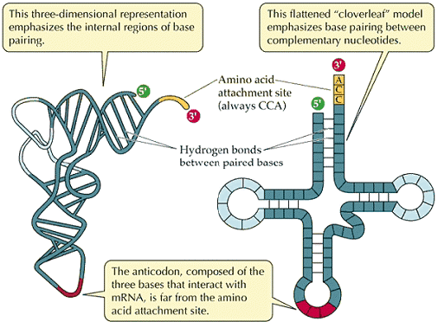
Structure of tRna
The anticodon region on the tRNA will match up to a specific codon on the mRNA based on base-paring rules.
An amino acid will temporarily attach to a site that is far removed from Anticodon region on tRNA.

Slide 35
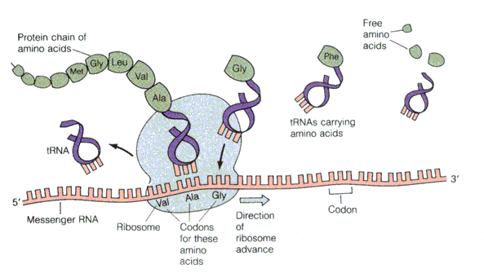
Stages of protein Synthesis: translation
Translation: RNA to PROTEIN
There are 20 different amino acids (AA) and 4 different nucleotides. Blocks of three nucleotides serve as the ‘codon’ for one amino acid.
Free amino acids
Growing Protein Chain
5
7
6
AA:tRNA
Anti-codon
4
free tRNA
8
Codon
1
3
mRNA
Ribosome
2
Codon for specific AA
3

Slide 36
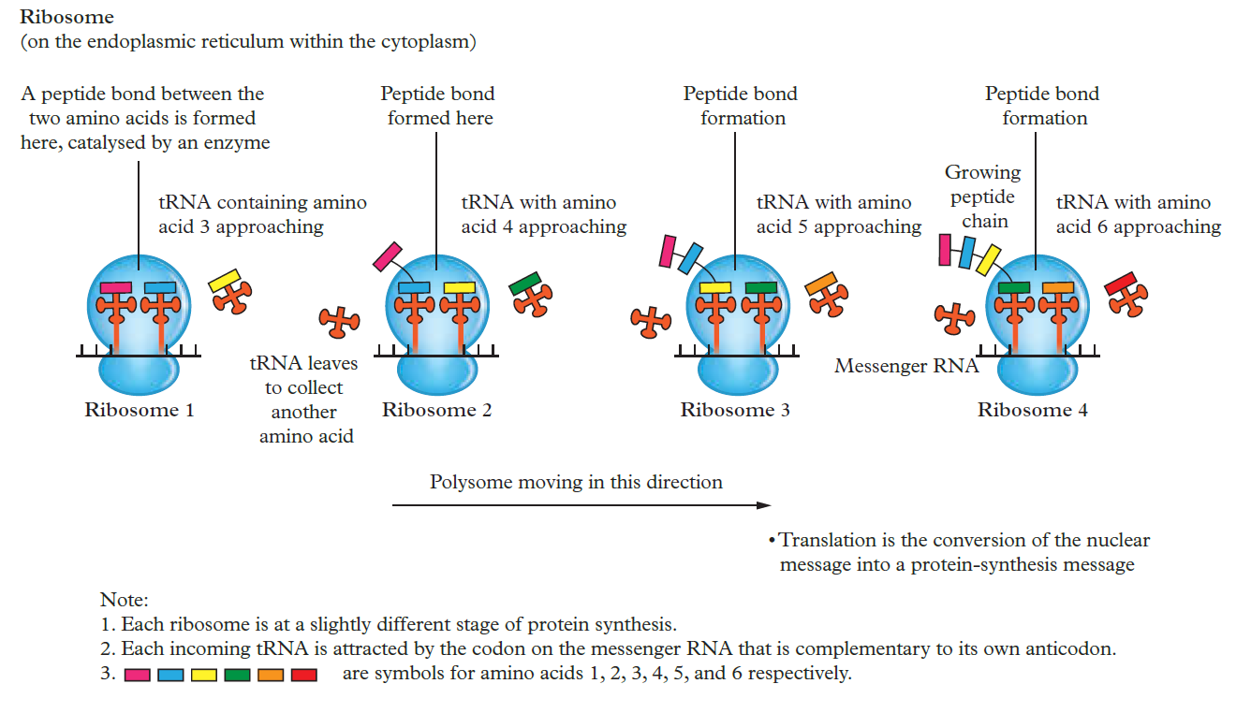
Stages of protein Synthesis: translation

Slide 37
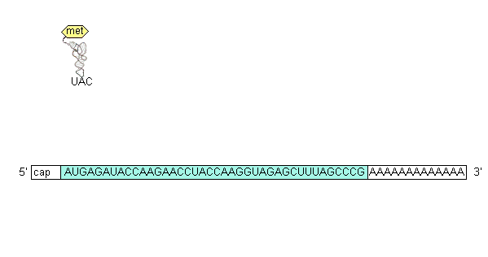
Stages of protein Synthesis: translation

Slide 38
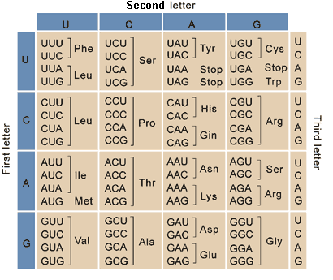
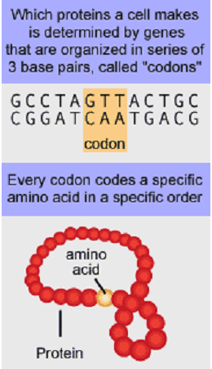
Stages of protein Synthesis: translation
Universal for all organisms

Slide 39
Exit ticket: c. explain the process of protein synthesis in terms of - translation of mRNA into an amino acid sequence at the ribosome (refer to transfer RNA, codons and anticodons)
Explain the process of protein synthesis in terms of translation of messenger RNA into an amino acid sequence at the ribosome (refer to transfer RNA, codons and anticodons) (3 marks)

Slide 40
Further research
Protein Synthesis updated
(Amoeba sisters).
https://www.youtube.com/watch?v=oefAI2x2CQM
2. Protein Synthesis
(Fuse school).
https://www.youtube.com/watch?v=x5ZXQo-xeMo
EXTENTION
3. DNA Structure and Replication
(Crash Course)
https://www.youtube.com/watch?v=x5ZXQo-xeMo

